Slide 1

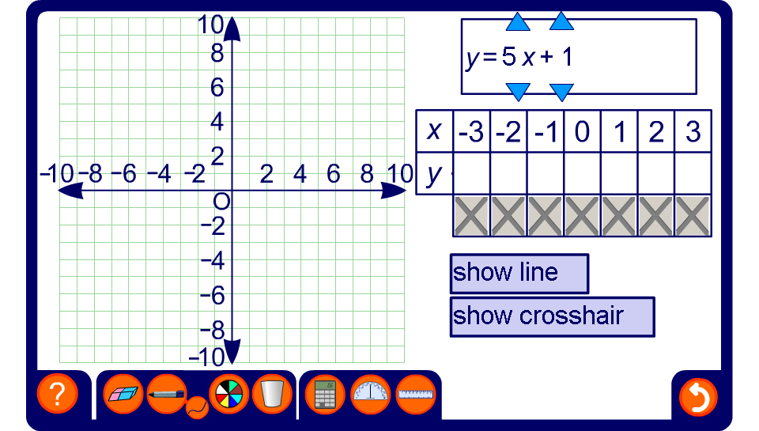


Plotting graphs of linear functions
Notes:
Start by choosing a simple function.
Remind pupils that we can draw graphs of functions by plotting inputs along the x-axis against outputs along the y-axis.
Talk through the substitution of each value of x in the table and click to reveal the corresponding value of y below it. Start with the positive x-values, if required, and work backwards along the table to include the negative values.
Explain that each pair of values for x and y corresponds to a coordinate that we can plot on the coordinate axis. For example, for the equation y = 2x, when x = 1, y = 2. This corresponds to the coordinate (1,2).
Click to plot each coordinate from the table of values onto the graph. Remind pupils that we always move along the x-axis and then up (or down) the y-axis when plotting coordinate points. A common mnemonic for this is ‘along the corridor and up the stairs’.
Once all the points have been plotted ask pupils what they notice, that is that all the points lie in a straight line.
Click ‘show line’ to draw a line through the points. Draw pupils attention to the fact that the line extends beyond either end of the points plotted on the graph.
Use the crosshair button to find the coordinates of other points on the line.Verify that all of these points satisfy the equation.
Ask pupils suggest other coordinates that would lie on this line. Establish that the line could be infinitely long and praise the most imaginative (correct!) answers.

